Slide 1
MOVIE RECOMMENDATION SYSTEM
Submitted By -
Omkar arade

Slide 2
Introduction
Movie recommender systems
A movie recommendation system, or a movie recommender system, is an ML-based approach for filtering or predicting the users’ film preferences based on their past choices and behavior.
Movie recommender system has the ability to predict whether a particular user would prefer an item or not based on the user’s profile.
This movie recommender system is content base recommender where we create a tags and try to find out similar types of movies.

Slide 3
Overview
First we will start with the data where we have two dataset
1. Movies
2. Credit
We merge two dataset and create one view. The data is spread across 4809 rows and 23 columns.
Then we eliminate the column which is not usable for this model.
After that we Pre-Processes data because we have some problem in dataset
I concatenate overview, genres, keywords, cast and crew variable to create Tags
And to find similar type of movie on the basis of tags, we create a text vectorization

Slide 4
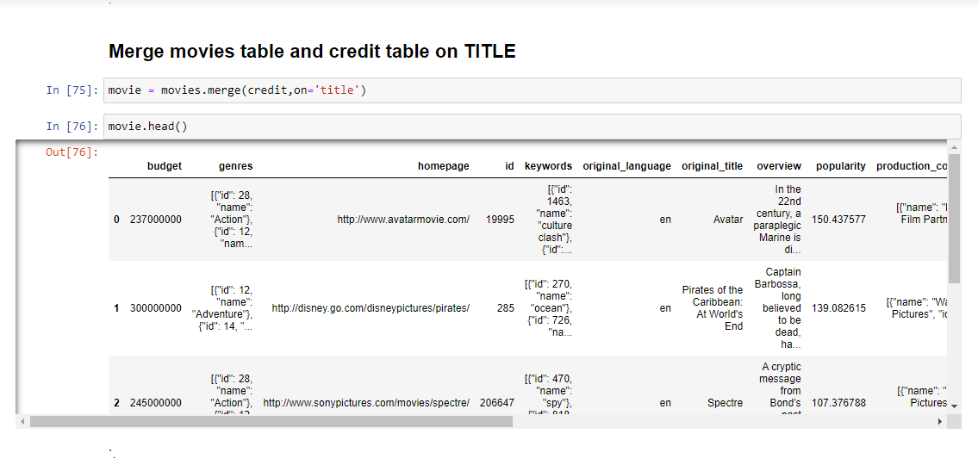
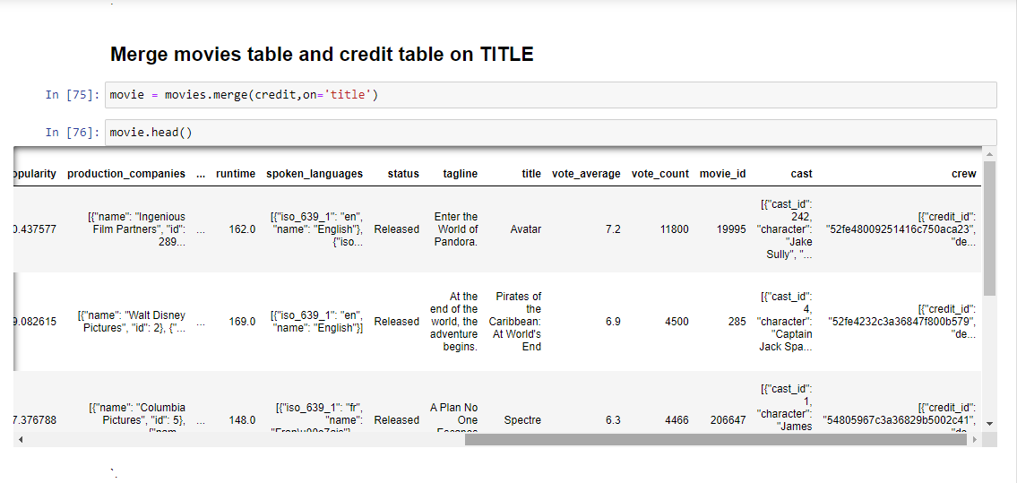
The Dataset
The data is spread across 4809 rows and 23 columns.
There are both numerical and categorical data.

Slide 5
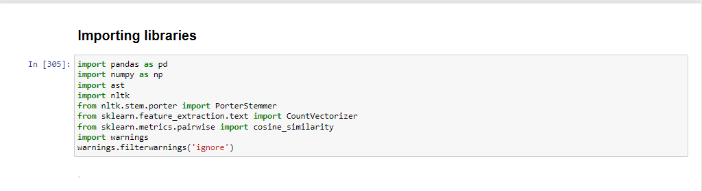
Python Libraries

Slide 6
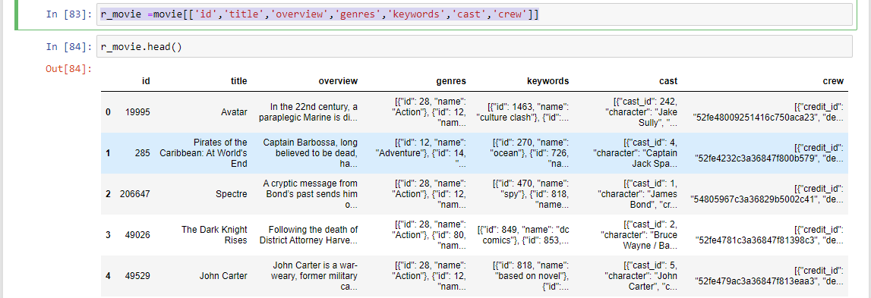
Then we Dropping the column which is not usable for this model.
We drop the unnecessary column and create new dataset. After dropping columns we have 4809 rows and 7 columns.
Syntax : r_movie =movie[['id','title','overview','genres','keywords','cast','crew’]]

Slide 7
Data Pre-Processing
Handled the missing values.
Fetch name form 'genres' and 'keywords’ columns.
Fetch top 3 actor name form ‘cast’ column and director name from ‘crew’ column.
Change the type of variable.
Concatenate overview, genres, keywords, cast and crew variable to create Tags column.
Create a text vectorization.

Slide 8
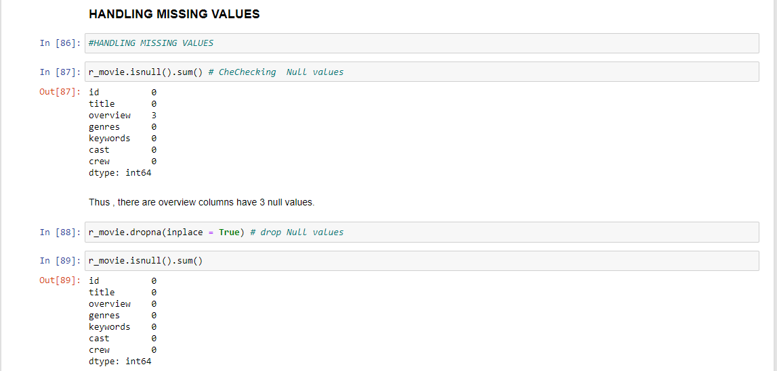
Handled the missing values.
In this dataset we have three missing values in overview column.
If we drop this three values we don’t have any impact on our model so we can drop it
Syntax: r_movie.dropna(inplace = True)

Slide 9
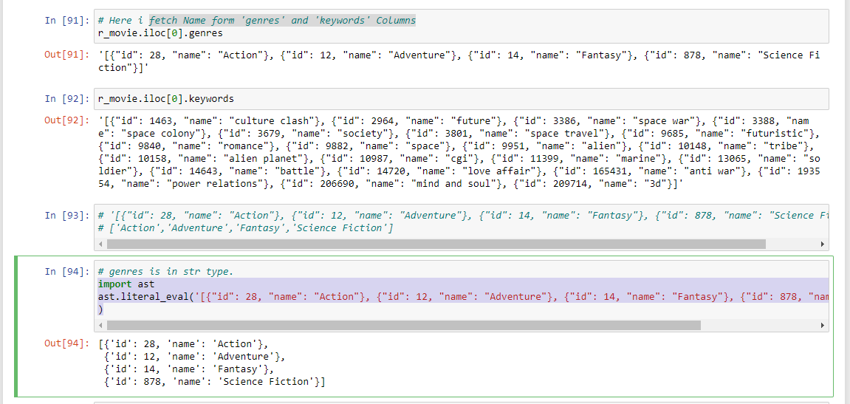
Fetch name form 'genres' and 'keywords’ columns.
In ‘genres’ column and ‘keyword’ column we have list of dictionary.
In dictionary we have keys as ID and there value as Name. We extract the name from dictionary and This name contain type of movie
To do that first convert these list of dictionary into string
than we can create helper function
Syntax : import ast
ast.literal_eval('[{"id": 28, "name": "Action"}, {"id": 12, "name": "Adventure"}, {"id": 14, "name": "Fantasy"}, {"id": 878, "name": "Science Fiction"}]'
)

Slide 10
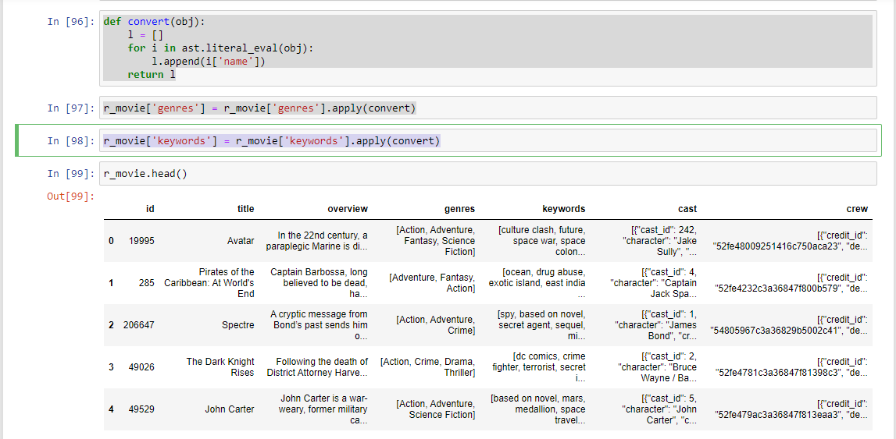
Then we create helper function and apply on genres column and keyword column helper function syntax : def convert(obj): l = [] for i in ast.literal_eval(obj): l.append(i['name']) return l r_movie['genres'] = r_movie['genres'].apply(convert) r_movie['keywords'] = r_movie['keywords'].apply(convert)

Slide 11
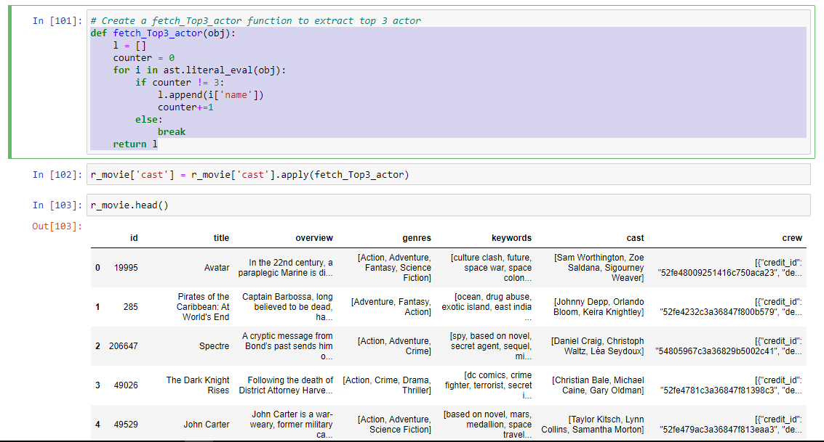
Fetch top 3 actor name form ‘cast’ column and director name from ‘crew’ column.
In ‘cast’ and ‘crew’ columns we have list of dictionary.
In dictionary we have keys and there values . We extract the top 3 Actor name and Director name from dictionary.
To do that we create helper function
Syntax :
def fetch_Top3_actor(obj):
l = []
counter = 0
for i in ast.literal_eval(obj):
if counter != 3:
l.append(i['name'])
counter+=1
else:
break
return l

Slide 12
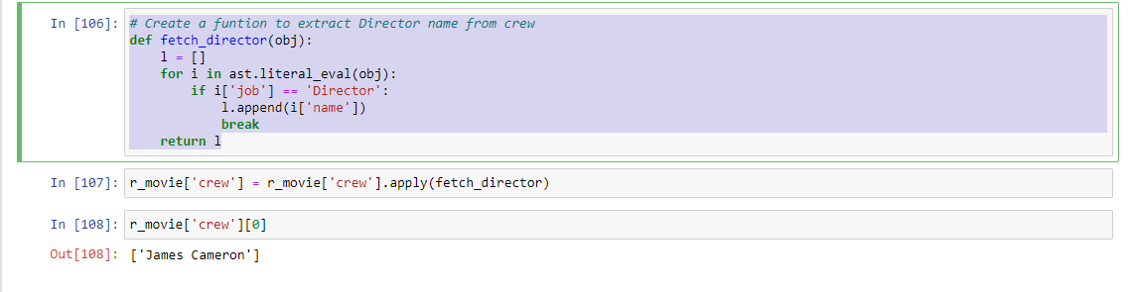
Create a funtion to extract Director name from crew Syntax: def fetch_director(obj): l = [] for i in ast.literal_eval(obj): if i['job'] == 'Director': l.append(i['name']) break return l

Slide 13
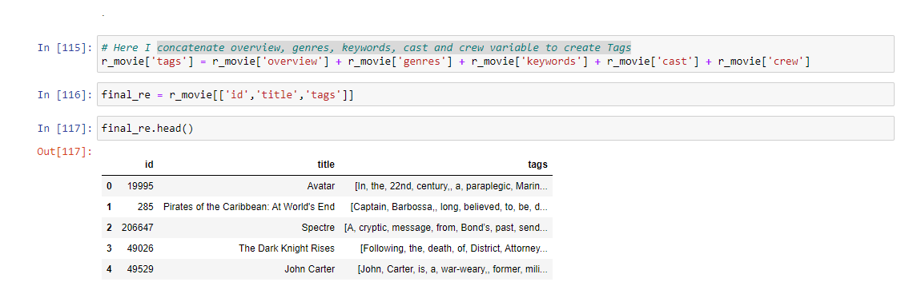
Concatenate overview, genres, keywords, cast and crew variable to create Tags column.

Slide 14
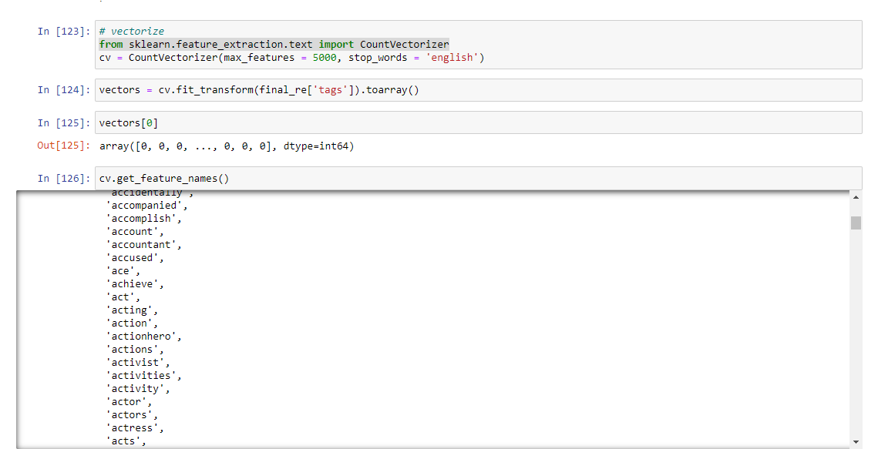
And to find similar type of movie on the basis of tags, we create a text vectorization
First we concatenate all the tags and we get large text. Than we extract top 6000 words who's frequency is most. Now we compare this 6000 words with tags to get similar types of movie.

Slide 15
When we doing Vectorization, We can see error like, in 6000 word, some words are repeated. Like adventur, adventure, adventures To resolve this we use stemming technique (i.e play, playing, played : play) and create def function Syntax : import nltk from nltk.stem.porter import PorterStemmer ps = PorterStemmer() def stem(text): y =[] for i in text.split(): y.append(ps.stem(i)) return " ".join(y)

Slide 16
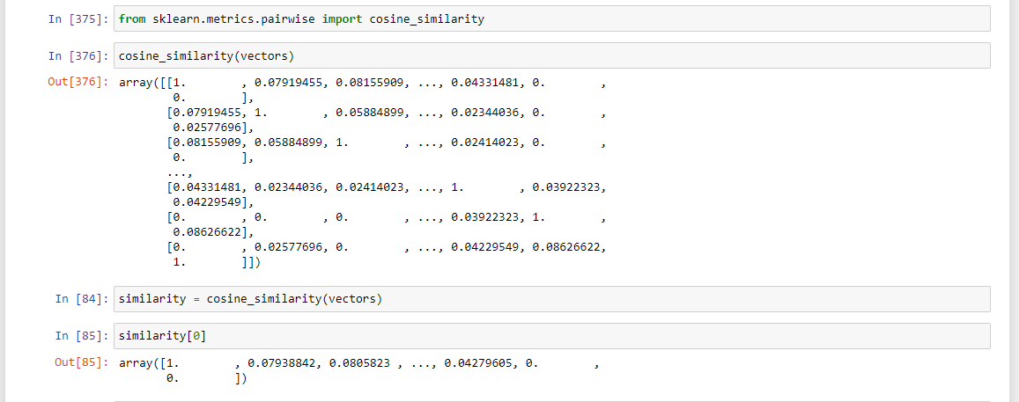
Now, we want to calculate distance (I.e. difference ) between every movie. If the distance is more, then similarity is less. To do that we use cosine distance (angle between two vectors)

Slide 17
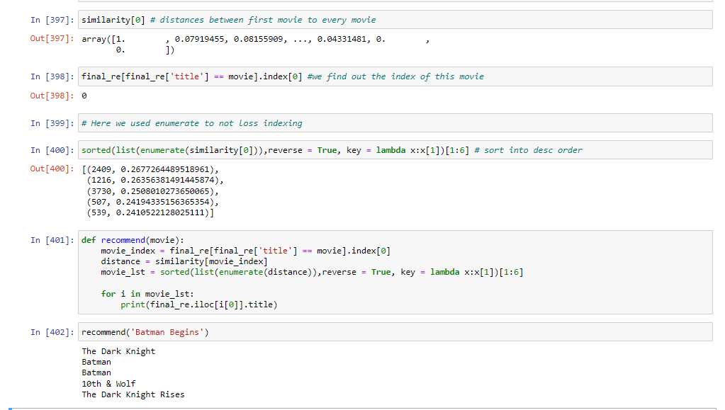
Conclusion
Finally we have created a function. In that function first we find out the index of this movie by using index, then we go to similarity matrix and we find those particular index movie and sort them in descending order and give them limit 5

Slide 18
Thank You!

